Slide 1
CS 205
Artificial Intelligence

Slide 2
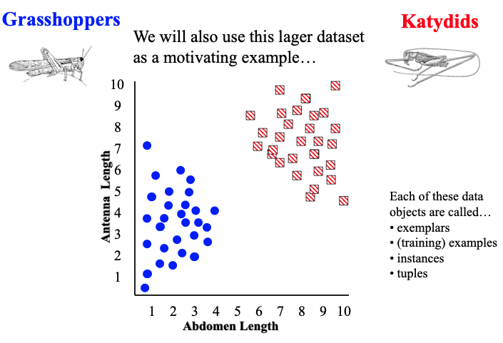
Classification
See Prof Eamonn's slides.

Slide 3
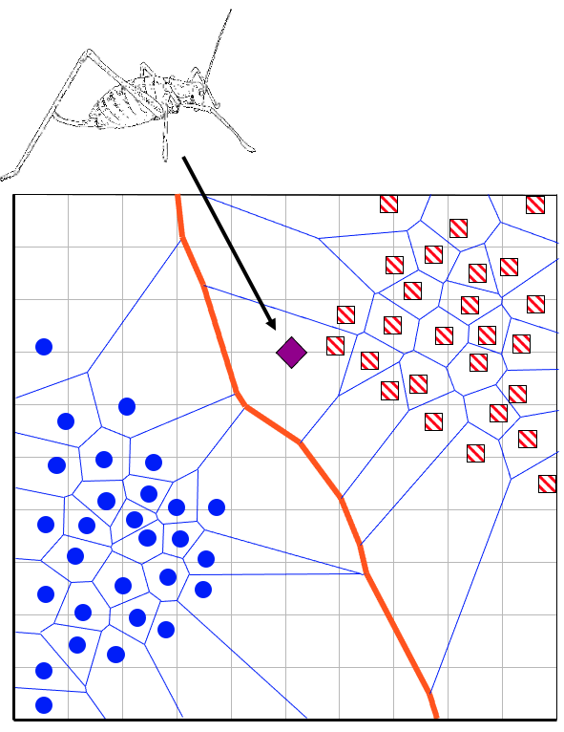
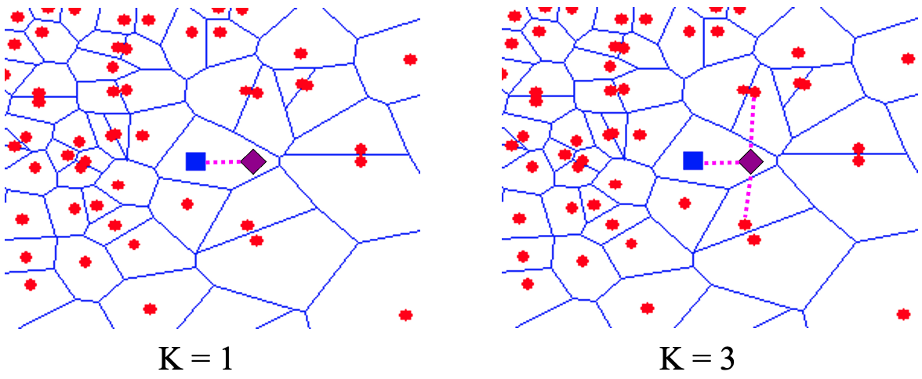
K-Nearest Neighbors
Easy to implement, just check:
Which are my nearest neighbors?
Assumption: I must me like one of them.

Slide 4
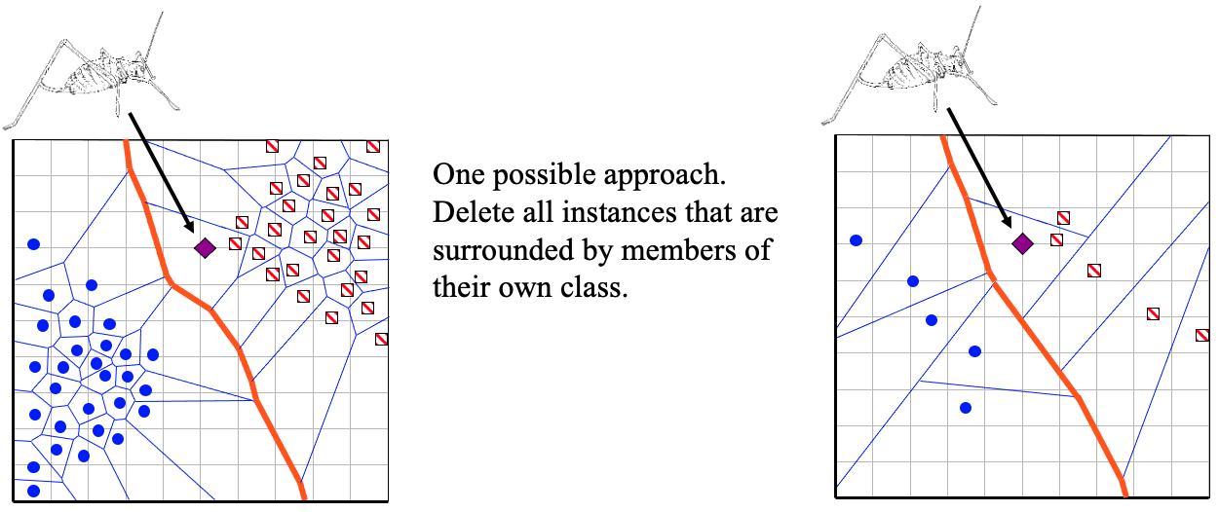
Issues with KNN
Sensitive to outliers: what if my nearest neighbor is a weirdo?
Computationally tractable, does not always mean practical.
What is the complexity of KNN?
What if I have a billion data points — how long does a single classification take?

Slide 5
.... Thanksgiving Detour: NLP
Every time I teach CS 205, we never get to spend any time on NLP.
Well, happy Thanksgiving, this year we will.
We will return to Classification again next week.

Slide 6
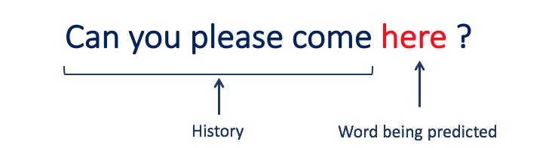
Natural Language Processing
N-gram Language Models
Chain Rule — joint probability of a sequence
Markov Assumption — approximate "near" history

Slide 7

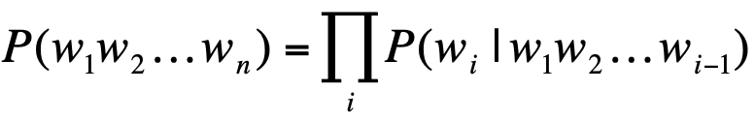


Chain Rule
P(here | Can you please come) =
P(Can you please come here) /
P(Can you please come)

Slide 8


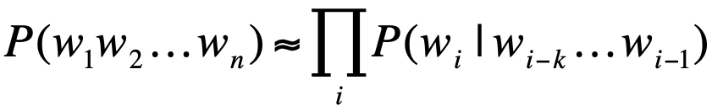

Markov Assumption
P(here | Can you please come) ~=
P(please come here) /
P(please come)
^^^ tri-gram model bi-gram model >>>

Slide 9
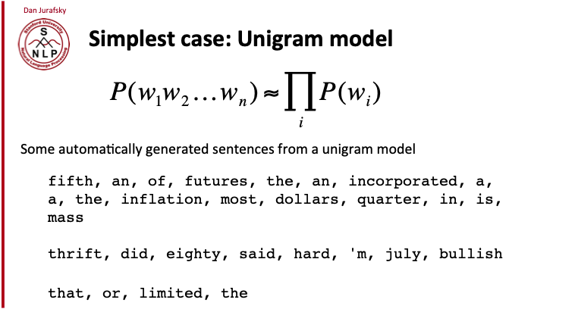
Unigram
Not great.
The sentences generated are meaningless sequences of frequent words.

Slide 10
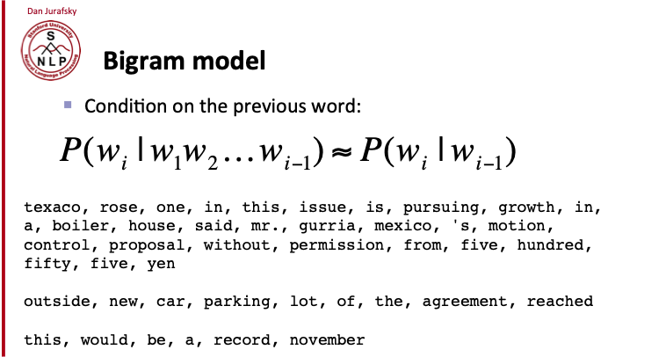
Bigrams
Better.
Words that go together starting to form coherence.

Slide 11
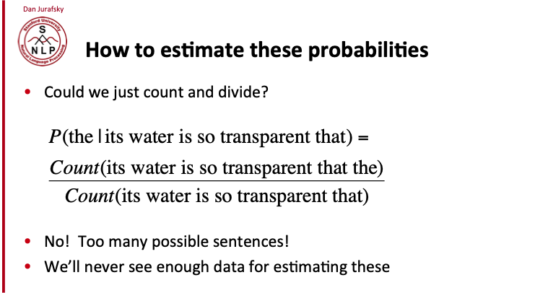
Should we just count the ways?
No!
There will never be enough tweets in the world...

Slide 12
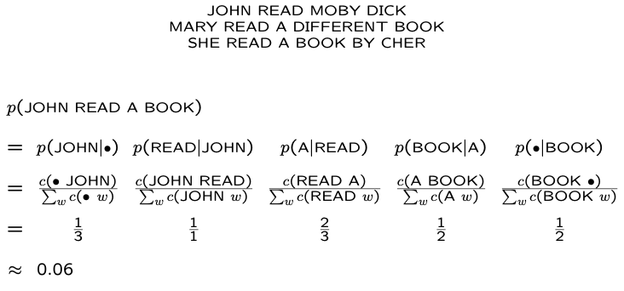
Example
So what's the probability that Cher read a book?

Slide 13
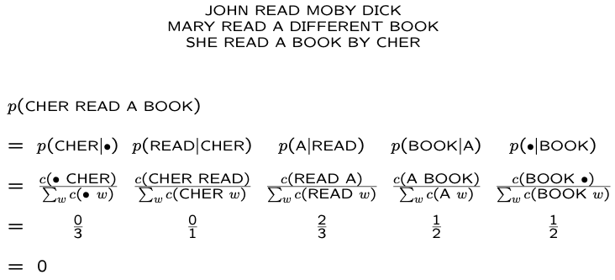

Try it!
What's the probability that Cher read a book?

Slide 14
Other topics in NLP
Tokenization and Segmentation
Part of Speech Tagging
Parsing
Semantic Role Labelling
Named Entity Recognition
Coreference Resolution
Relation Extraction
Temporal Resolution
Information Extraction
Topic Modelling
Text Summarization
Sentiment Analysis
Discourse Parsing
Speech Synthesis
Question Answering
Machine Translation
Language Generation
Ontology Population
NL Understanding
Text Coherence
Fake News Detection
For example, drugs in the US cohere in a distinctive Ontology called RxNORM. My research team, gathers, extracts, applies and expands upon medical knowledge of this sort, as well as diseases, devices and procedures.
https://mor.nlm.nih.gov/RxNav/?

Slide 15
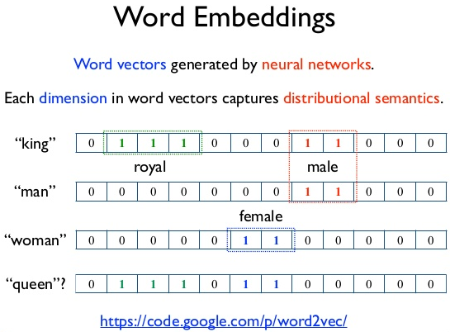
Modelling Techniques in NLP
N-Gram Language Models
Distributional Semantics
Vector-based Models
Regular Expressions
Local Grammars
Hidden Markov Models
Maximum Entropy Models
Conditional Random Fields
Representation Learning
Deep Neural Networks

Slide 16
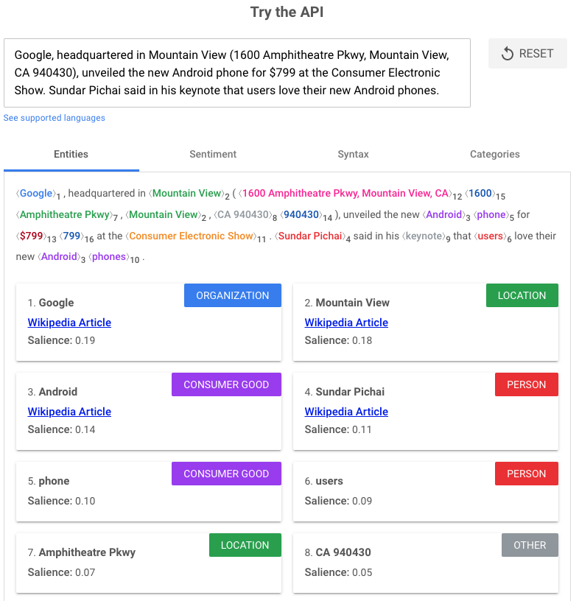
Fun with NLP toolkits
Built a chatbot! Super easy these days. Maybe even your final project?
https://cloud.google.com/products
DialogFlow
Cloud Natural Language
Speech to Text and Text to Speech

